Slide 1

Automated Attendance System
Welcome to the presentation on the Automated Attendance System, a comprehensive solution designed to revolutionize attendance tracking in educational institutions. This system leverages the power of facial recognition technology and PostgreSQL database to provide accurate, efficient, and secure attendance management.
Presented by Raghuraj Pratap Yadav

Slide 2


Introduction
1
Streamlined Attendance
The Automated Attendance System simplifies the process of marking attendance, eliminating the need for manual roll calls and reducing the time spent on attendance management.
2
Enhanced Accuracy
Facial recognition technology ensures high accuracy in identifying students, minimizing errors and improving the reliability of attendance data.
3
Real-time Tracking
The system captures attendance data in real-time, providing educators and administrators with up-to-the-minute insights into student presence.
4
Security and Privacy
Data security is paramount. The system employs robust security measures to protect sensitive student information, ensuring compliance with privacy regulations.

Slide 3
Objectives
Automation
Accuracy and Efficiency
Data Management
To automate the process of marking attendance, freeing up educators and administrators from tedious manual tasks.
To enhance the accuracy and efficiency of attendance tracking, minimizing errors and providing reliable data.
To securely store and manage attendance data in a centralized database, enabling easy access and analysis.

Slide 4
System Architecture
Image Capture
1
The system uses web cameras or other image capture devices to capture images of students entering the classroom.
2
Facial Recognition
Captured images are processed using OpenCV and DeepFace libraries to identify students based on their facial features.
Attendance Marking
3
Once a student is identified, their attendance is automatically marked in the PostgreSQL database.
4
Report Generation
The system generates comprehensive attendance reports based on the data stored in the database.
Email Delivery
5
Reports are automatically sent to faculty members and administrators via email, providing timely updates on attendance patterns.

Slide 5


Requirements
Python
The system is built using Python 3.8+, leveraging the power of Python's libraries for image processing, data manipulation, and database interaction.
OpenCV and DeepFace
OpenCV and DeepFace are used for facial recognition, enabling the system to accurately identify students based on their facial features.
PostgreSQL
PostgreSQL is a powerful and reliable database system chosen to securely store and manage attendance data.
Additional Libraries
The system relies on libraries such as Pandas, Numpy, Psycopg2, SQLAlchemy, and smtplib for data processing, database interaction, and email communication.

Slide 6

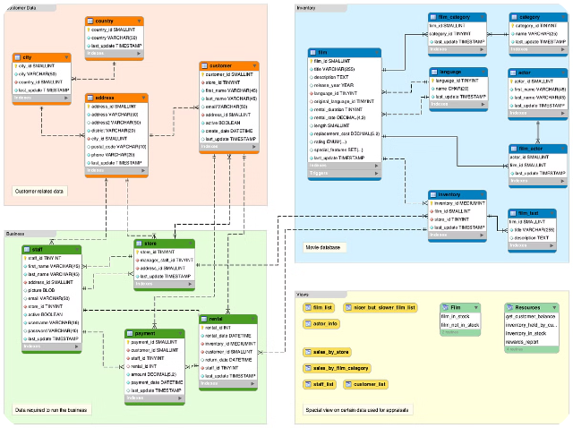
Database Configuration
Database Name
autoattendance
Username
postgres
Password
Postgre
Host
localhost
DB_PARAMS = {
"dbname": "autoattendance",
"user": "postgres",
"password": "Postgre",
"host": "localhost"
}

Slide 7

Demo
Get ready to experience the power of our automated attendance system in action! Watch as the system effortlessly tracks attendance, generates reports, and simplifies administrative tasks. See firsthand how it saves time, improves accuracy, and enhances efficiency. Be prepared to be amazed!

Slide 8
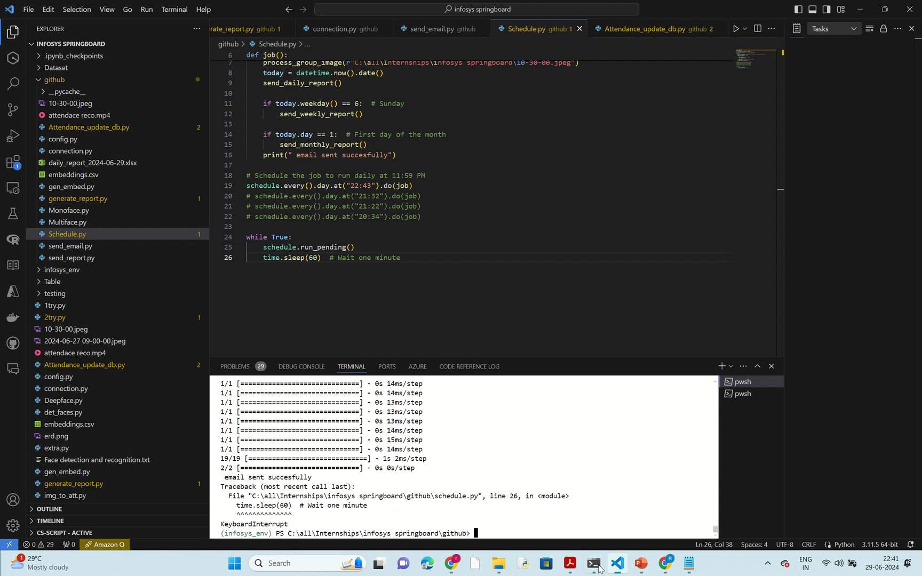

Video Demo
Watch our video demo to see the automated attendance system in action! Get a comprehensive overview of the features and functionalities that make our system stand out. Discover how it can streamline attendance tracking, simplify reporting, and revolutionize your administrative tasks. Don't miss out on this informative and engaging video!

Slide 9





Email Configuration
Sender Email
Configure the sender email address and password to enable email notification functionality.
Faculty Email List
Specify the email addresses of faculty members to receive attendance reports.
Director Email
Set the email address of the school director for receiving attendance reports.
EMAIL_CONFIG = {
"sender_email": "support@aptpath.in",
"sender_password": "your_password"
}
faculty_emails = ["faculty1@example.com", "faculty2@example.com"]
director_email = "director@example.com"

Slide 10


Conclusion
1
Benefits
The Automated Attendance System offers a range of benefits, including improved accuracy, efficiency, security, and real-time tracking of attendance data.
2
Potential Enhancements
Future enhancements might include integrating the system with school management software, adding real-time attendance dashboards, and implementing facial recognition for attendance at school events.
3
Questions?
We encourage you to ask any questions you may have about the Automated Attendance System. Your feedback is valuable and helps us improve our solutions.

